Slide 1
Confluence Tutorial

Slide 2
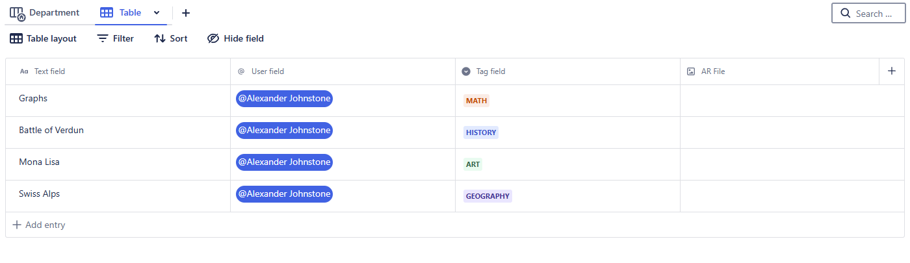
Adding new file
Go to table view
Press “add entry”

Slide 3
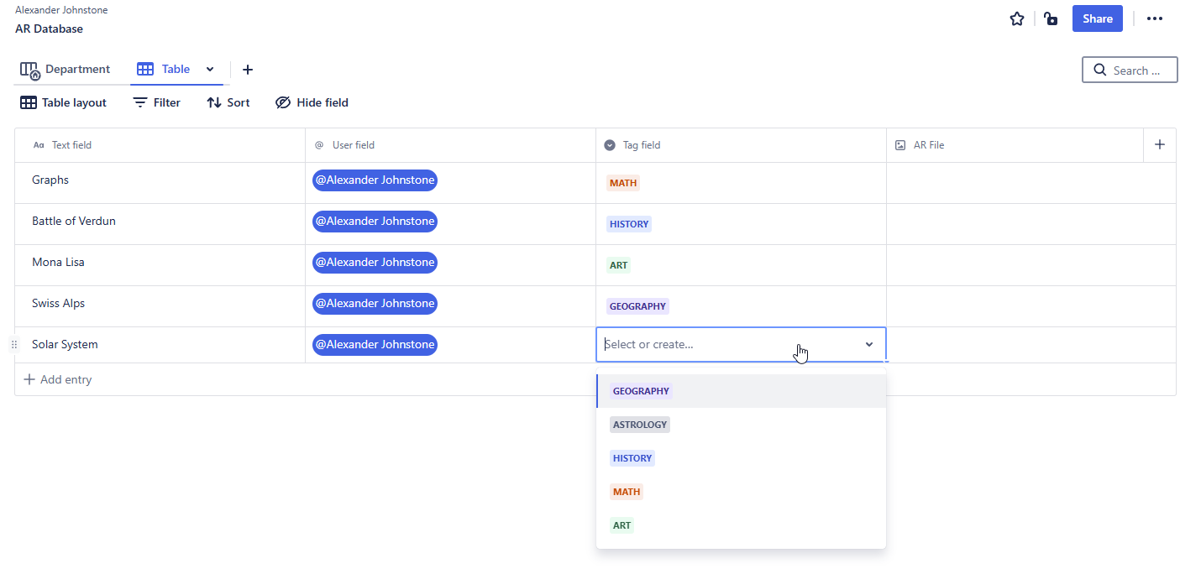
Select tag
Select the tag that relates to the subject the AR file is associated with

Slide 4
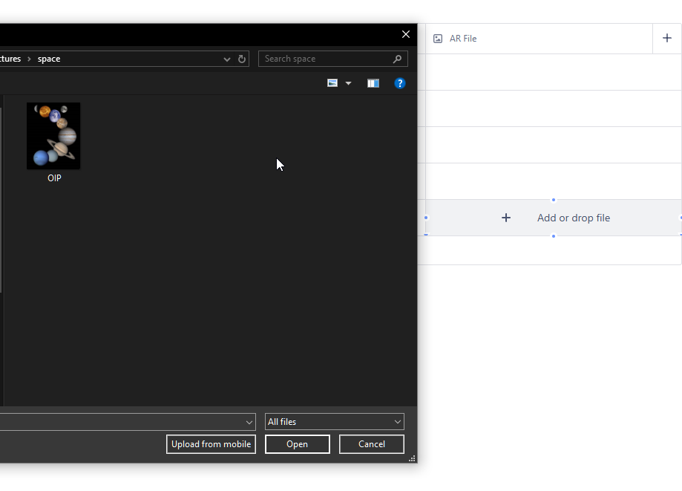
Add file
Upload file

Slide 5
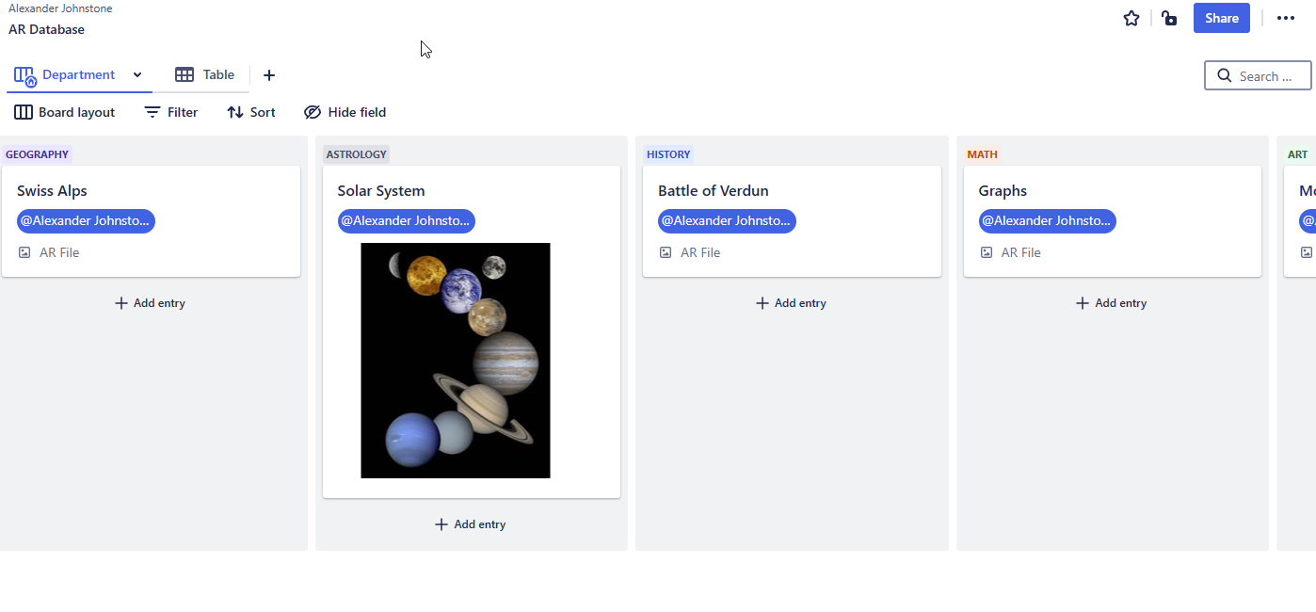
Change view
Department view for easier viewing of each subject

